Slide 1
Weathering the Storms:
Stabilization Efforts in Europe and in Hungary
By Prof. István MAGAS
BCU, Department of World Economy
2014.12.2.

Slide 2
Questions
Do we have solid theoretical foundations of financial crisis management?
Are the patterns of macro adjustment the same in developed and in emerging market environments?
Is the small open non euro-zone economy an exception to the patterns ?

Slide 3
Debt reduction options
Economic growth
Fiscal austerity
Explicit de jure ( default ) restructuring
Inflation surprise
A steady doze of financial repression and high inflation
C. M. Reinhart- K. Rogoff(2013):Financial and Sovereign Debt Crises, Some Lessons Learned and Those Forgotten, IMF, WP, /13/266

Slide 4
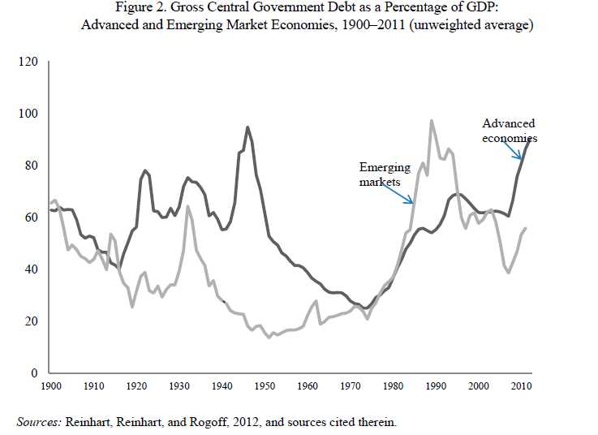
Gov’t debt levels in retrospect, 1900-2010

Slide 5
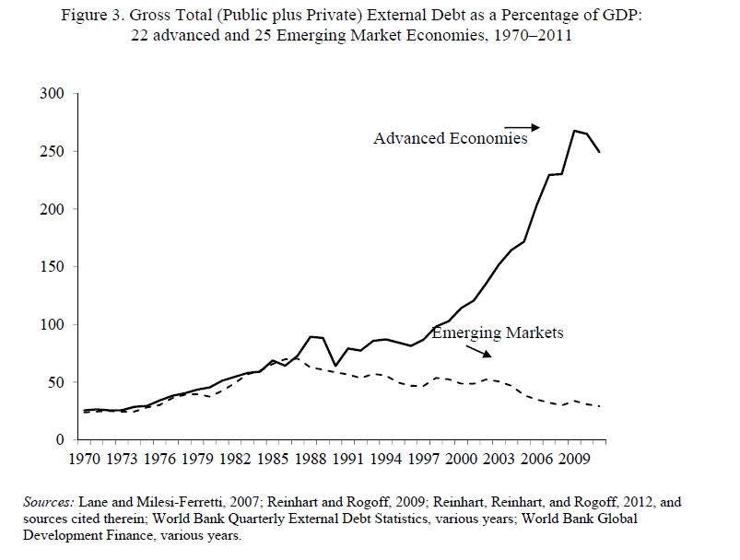
Total debt as a % of GDP: Advanced and emerging economies

Slide 6
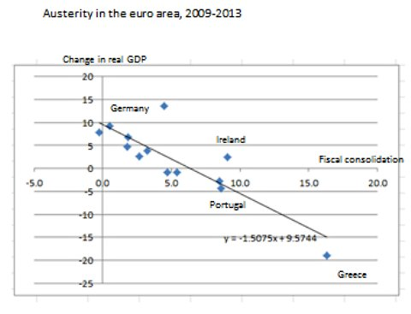
P. KRUGMAN’S VIEW: ill-timed restrictions

Slide 7
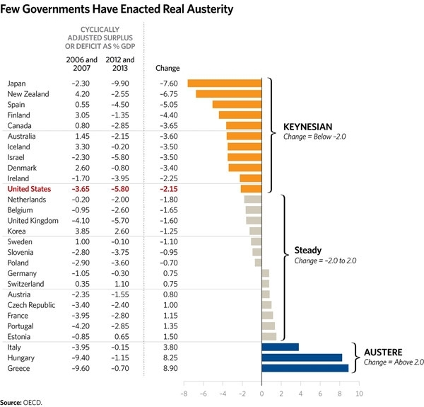
AUSTERITY AND KEYNESIAN ADJUSTMENTS

Slide 8
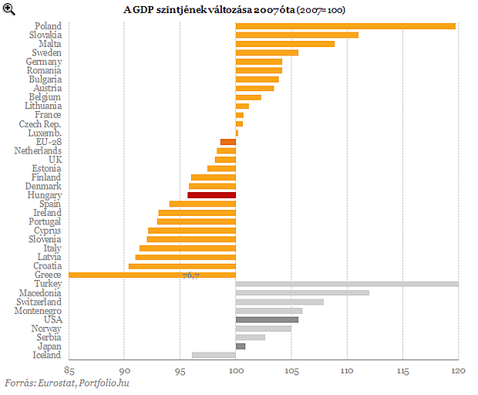
Post-crisis GDP landscape 2007=100

Slide 9
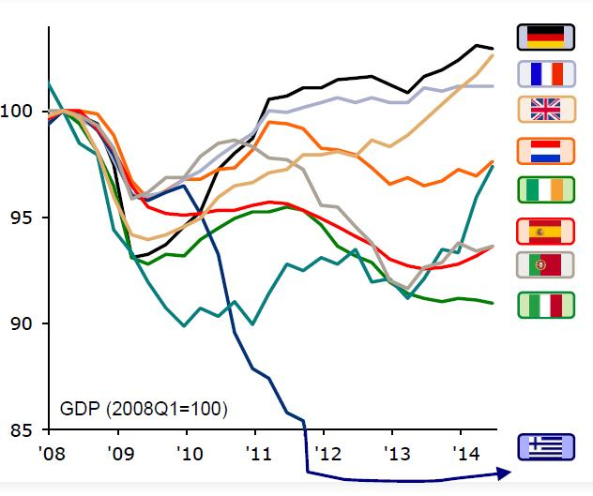
Sluggish Post-crisis Growth in the EU

Slide 10
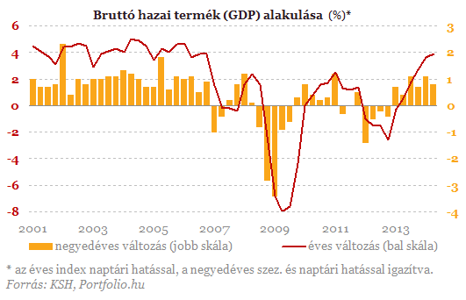
GDP Hungary, 2001-2013 q/q (yellow mark) and year/y (red line) %

Slide 11
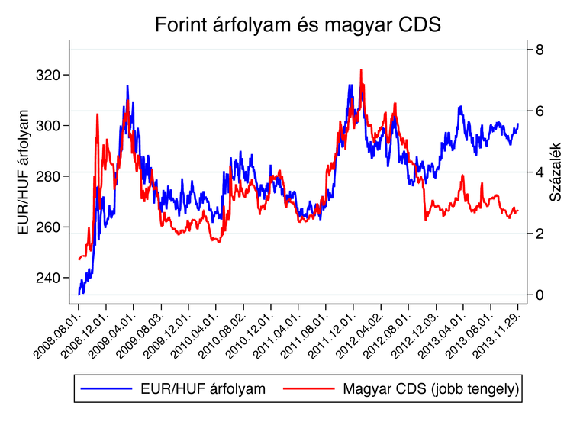
HUF/Euro ( left scale) and CDS (right scale, %) 2008-2013-Nov

Slide 12
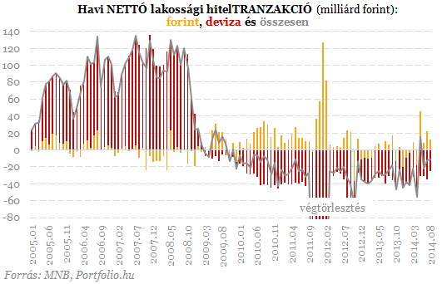
Contraction of fx-based lending (red mark), HUF-based ( yellow mark), 2005-2014 Bill of Huf

Slide 13
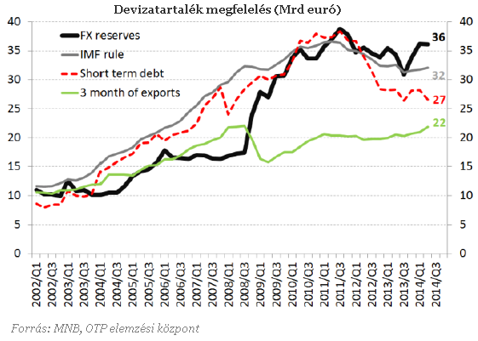
Moderate growth helped FX reserves Bill. of Euro

Slide 14
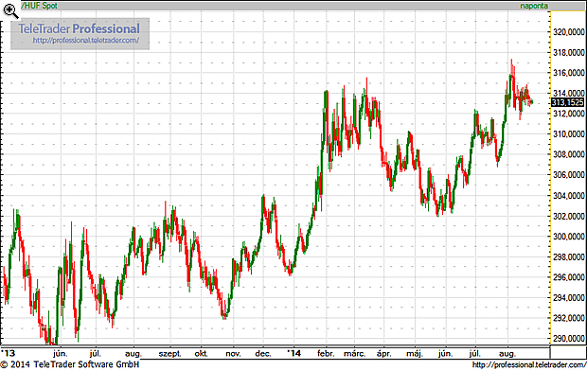
Weakening HUF in 2013-2014

Slide 15
Conclusions
A wide range of Keynesian and austerity type adjustments appeared on the global map.
There was not anything like a unified shock absorption pattern .
As the euro area is painfully learning, the lines
between national debt and common currency area-wide debt can also become blurred in a
financial crisis.

Slide 16
Conclusions Cont.
For a small open economy, like Hungary the large and increasing external indebtedness made macro adjustments more difficult.
Both private and public external debt should have been reduced earlier, when euro-zone membership faded away.
The fx-based mortgage market froze, it almost collapsed .
Austerity measures and fiscal tightening became inevitable.
The Future growth potential is still being dampened as a price to be paid for the delayed stabilization efforts

Slide 17
I THANK YOU FOR YOUR ATTENTION !

